Slide 1
STROKE PREDICTION +OPTIMISATION ALGORITHM USING MACHINE LEARNING
Amity School of Engineering and Technology
BY:
Akshat Khanna
A2305220137
4CSE-1-Y
UNDER GUIDANCE OF:
DR Supriya Raheja
DEPARTMENT OF COMPUTER SCIENCE & ENGINEERING
AMITY SCHOOL OF ENGINEERING AND TECHNOLOGY NOIDA, UTTAR PRADESH

Slide 2

Index
S NO | CONTENT | PAGE NO
1 | PROBLEM STATEMENT | 1
2 | ABSTRACT | 2
3 | LITERATURE REVIEW | 3
4 | METHODOLOGY | 4
5 | ABOUT DATA | 5
6 | EXPLORATORY DATA ANALYSIS | 7
7 | OUTLIER REMOVAL | 8
8 | NORMALISING | 9
9 | LABLE ENCODING | 11
10 | PARTITIONING OF DATA | 13
11 | TRAINING OF MODEL | 14
12 | RESULTS AND MODEL EVALUATION | 15
13 | CONCLUSION AND FUTURE SCOPE | 17
14 | REFERENCES | 18

Slide 3
Abstract:-
Due to modern stressful conditions and deteriorating health conditions, including but not limited to hypertension, kidney and liver functioning and BMI fallacies, stroke has become one of the most prominent reasons of death, partial and complete paralysis, and lifelong disabilities.
Given this predicament, machine learning can prove to be useful tool to make systematic predictions and aid as a decision-making tool.
This paper aims to employ a hybrid approach in order to detect strokes using a combination of machine learning algorithms and concepts while minimising the Type 1 and Type 2 error and maximizing accuracy via hyper parameter tuning and various optimisation methods.
Artificial intelligence has been making great breakthroughs in medicine and one probable action path can be to employ various machine learning algorithms to an imbalanced data set containing features such as occurrence of hypertension, body mass index level, heart disease, average glucose level, smoking status, previous stroke and age and predicting the probability of a stroke for a given individual.

Slide 4
Literature Review
S. NO | TITLE OF PAPER AND AUTHORS | MAIN CONTRIBUTION
1 | Integrated Machine Learning Approaches for Predicting Ischemic Stroke and Thromboembolism in Atrial Fibrillation Xiang Li ¹, Haifeng Liu ¹, | Integrated machine learning and data mining approaches to build 2-year TE prediction models for AF from chinese atrial fibrillation registry data
2 | Risk factor identification for stroke prognosis using machine-learning algorithms Tanvir Ahammad, | This article presents an enhanced approach for identifying the potential risk factors and predicting the incidence of stroke on a publicly available clinical dataset. It incorporates ten classification models, including advanced boosting classifiers, to detect the presence of stroke.

Slide 5
Literature Review
S. NO | TITLE OF PAPER AND AUTHORS | MAIN CONTRIBUTION
3 | The Use of Deep Learning to Predict Stroke Patient Mortality Songhee Cheon | Principal component analysis (PCA) featuring quantile scaling was used to extract relevant background features from medical records; we used these to predict stroke. We compared our method (a scaled PCA/deep neural network [DNN] approach) to five other machine-learning methods.
4 | Practical Machine Learning Model to Predict the Recovery of Motor Function in Patients with Stroke Kim J.K. | Created a practical ML model using the most common data measured in almost all rehabilitation hospitals as input data. Demographic and clinical data, including modified Brunnstrom classification (MBC) and functional ambulation classification (FAC), were collected when patients were transferred to the rehabilitation unit and 6 months after stroke onset and were used as input data.

Slide 6
Methodology:-
Data will be split into training and testing modules and worked upon with machine learning algorithms.
Accuracy and efficiency of model will be calculated, and conclusions will be presented in visual format and compared.
Feature generation and scaling will need to be employed to increase the data set utility.
Before feeding this data, it would need to be preprocessed as well as cleaned by removing irrelevant data

Slide 7
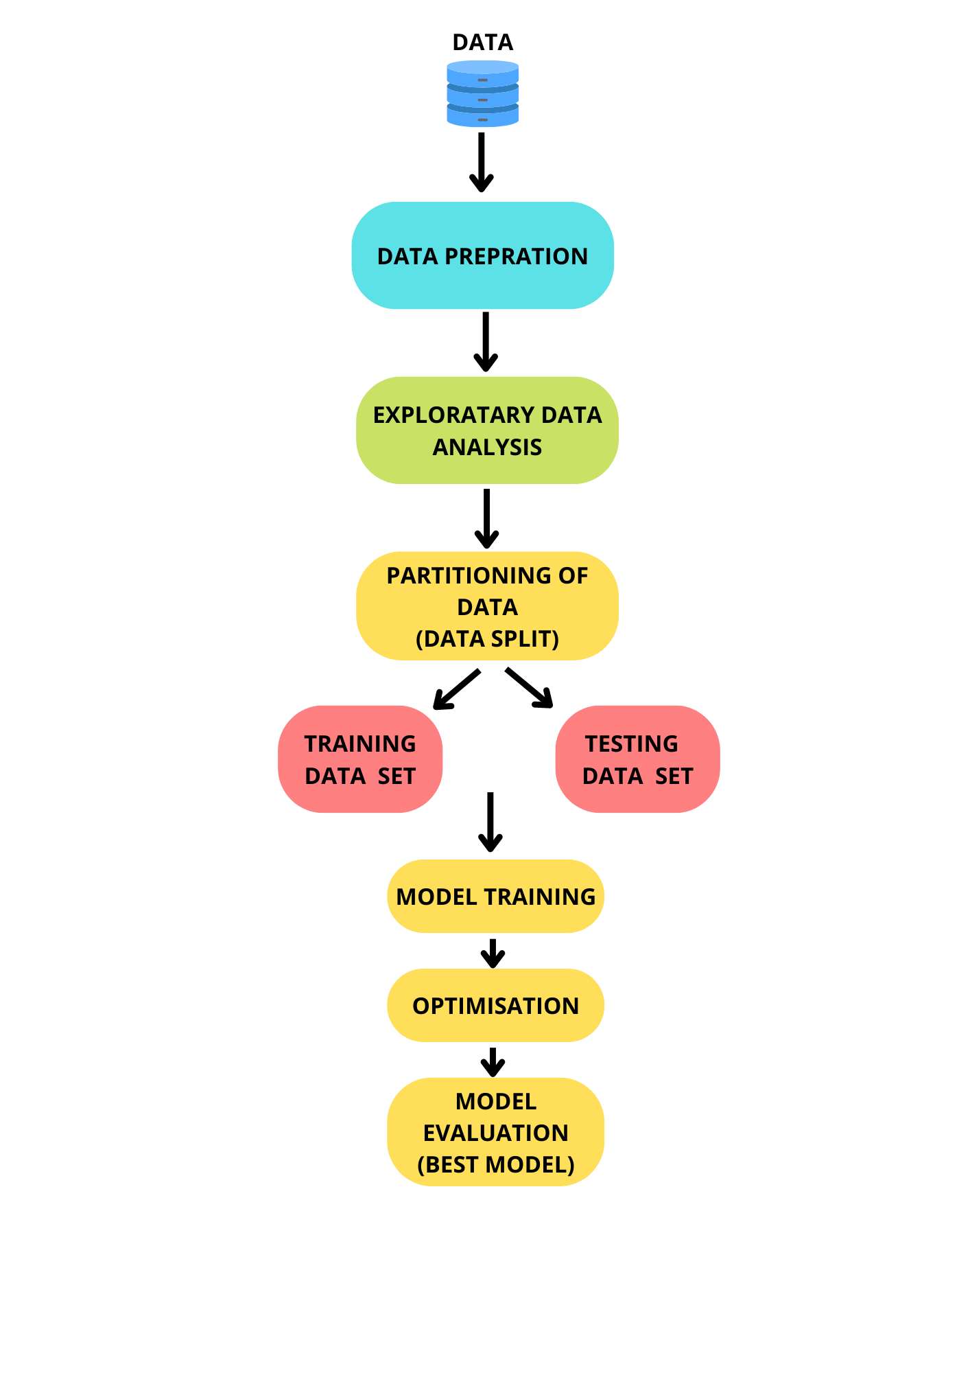

Slide 8
ABOUT DATA :
The dataset has been taken from Kaggle
based on several parameters (age, gender, id, hypertension, heart_disease, smoking_status, work_type, residence_type, ever_married, avg_glucose_level, stroke)
provides relevant information of patient and the output is a binary label ‘stroke’ ∈ {0, 1} which tells whether a person would suffer stroke or not.
This dataset has information of 5110 people where each row contains relevant information about a person.

Slide 9
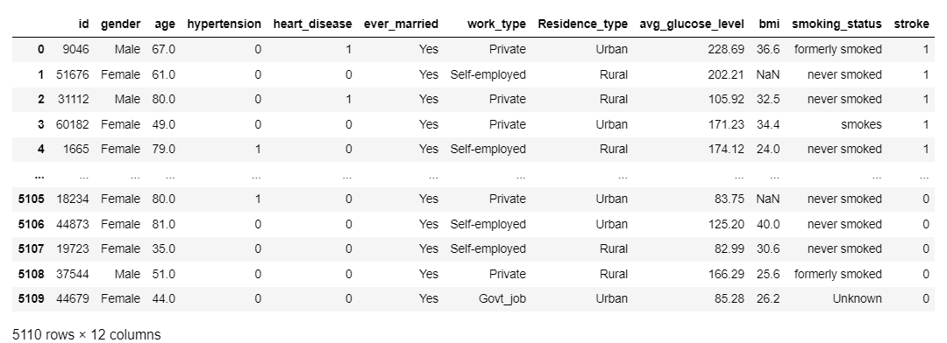
About data :

Slide 10
Exploratory Data Analysis:-
Exploratory data analysis is a technique that is being used by data analyst and scientist alike in order to analyze an exam in various data sets and summarize the main characteristics results an important features.
All of the data is complete and free of irregularities and errors due to this as well the data analysis progress slows down and the medical diagnosis cannot be done in an efficient manner. Data has a lot of null values in the BMI column which can affect the accuracy of judgement of the model adversely.
The data also required outlier removal and normalising the different attributes

Slide 11
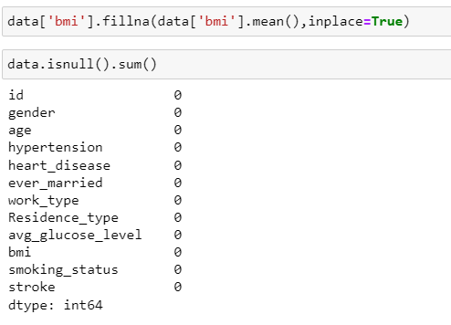
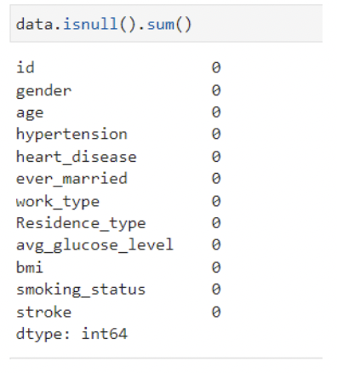
DIFFERENT TYPES OF DATA TYPES

Slide 12
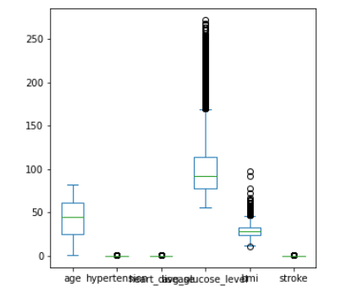
Outlier Removal
When modeling, it is important to clean the data sample to ensure that the observations best represent the problem.
Sometimes a dataset can contain extreme values that are outside the range of what is expected and unlike the other data. These are called outliers and often machine learning modeling and model skill in general can be improved by understanding and even removing these outlier values.
Simple univariate statistics like standard deviation and interquartile range to identify and remove outliers from a data sample.

Slide 13
Normalisation Of Data:-
Data normalization is the organization of data to appear similar across all records and fields.
It increases the cohesion of entry types leading to cleansing, lead generation, segmentation, and higher quality data.
Simply put, this process includes eliminating unstructured data and redundancy (duplicates) in order to ensure logical data storage. When data normalization is done correctly, you will end up with standardized information entry.
0.0800 to 82.00( too much variation)
For normalising we will use :-
“from sklearn.preprocessing
import StandardScaler std=StandardScaler()”
this will remove this variation

Slide 14
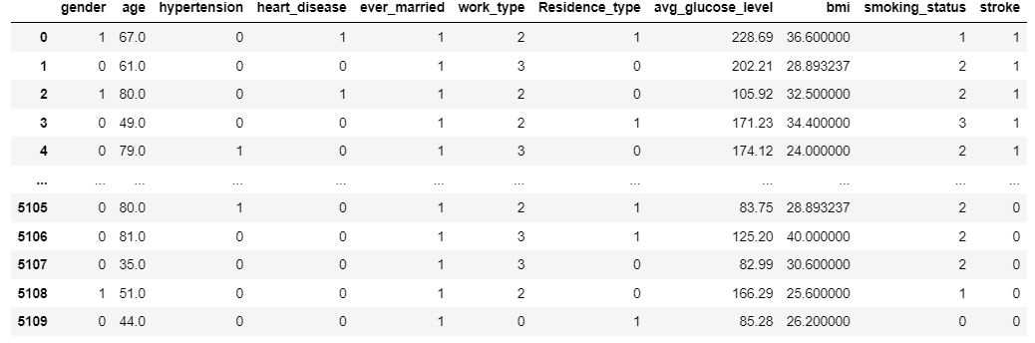
Label Encoding
Now we will have to encode the dataset in order to make it readable by the machine:- There are many ways to encode but we have used Label encoding to encode the data so that the terms get converted into different binary unique ids so its easy way to predict the data and hence easy readability and comparing gets easy.

Slide 15
Partitioning Of Data:- (Splitting the Data into training & Testing data set)
To boost database management or query processing efficiency, data partitioning is a method that divides data among many tables, drives, or locations.
Now in order to use ML Algorithms and predict the stroke we need to split the data in two parts.
Hence 80% of data goes in training part rest 20% in the testing part. y-train/test this is the dataset which we will use in mapping with x-test results in order to view the accuracy of prediction.

Slide 16
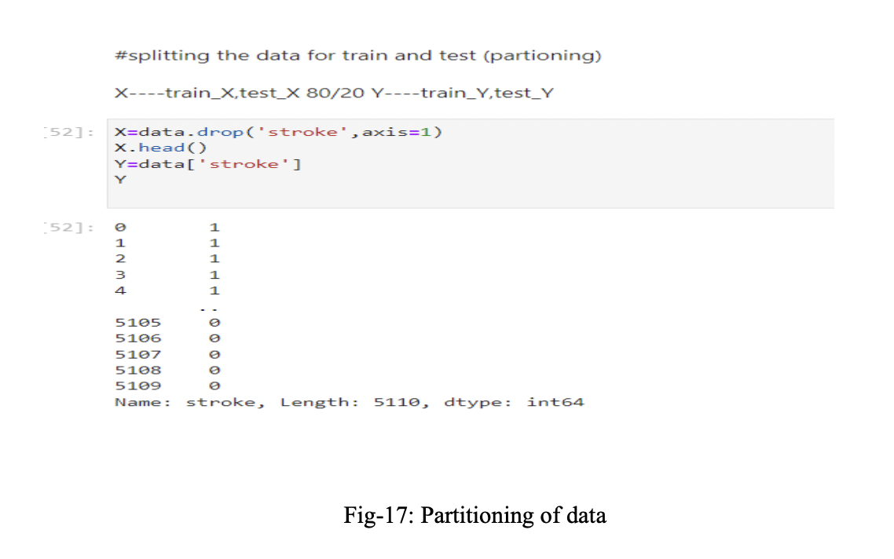
Partitioning Of Data:- (Splitting the Data into training & Testing data set)

Slide 17
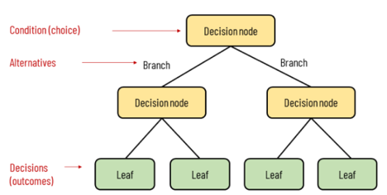
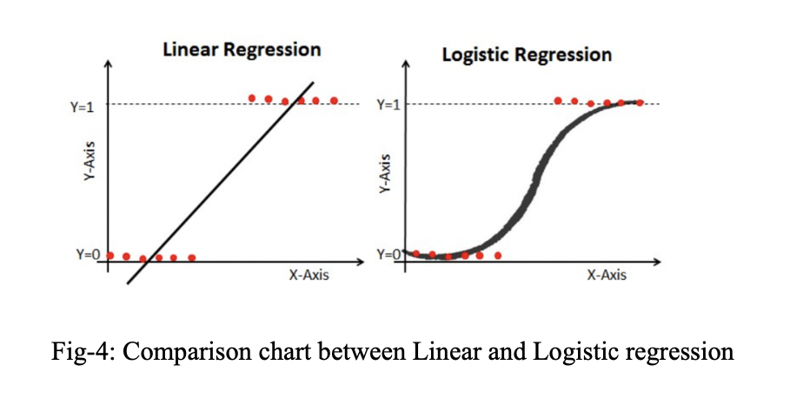
TRAINING OF MODEL:- (APPLICATION OF ALGORITHM)
2. LOGISTIC REGRESSION-
Logistic regression estimates the probability of an event occurring, such as voted or didn’t vote, based on a given dataset of independent variables. Since the outcome is a probability, the dependent variable is bounded between 0 and 1.
1.DECISION TREE-
In a decision tree, which resembles a flowchart, each internal node indicates a test on an attribute, each branch shows the test's result, and each leaf node (or terminal node) has a class label.

Slide 18
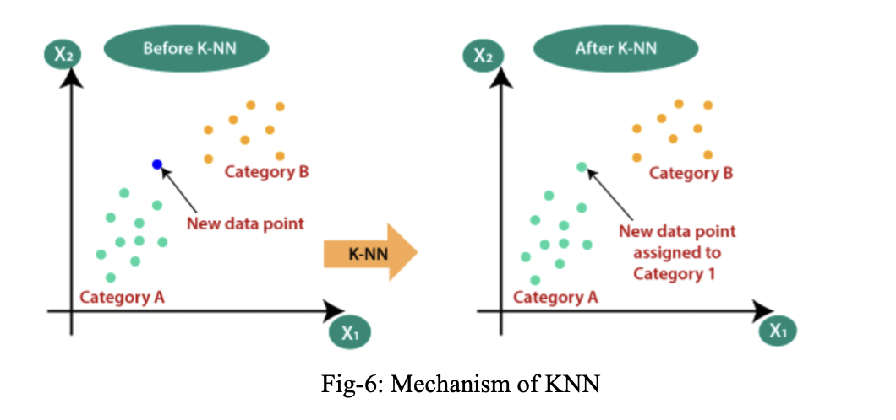
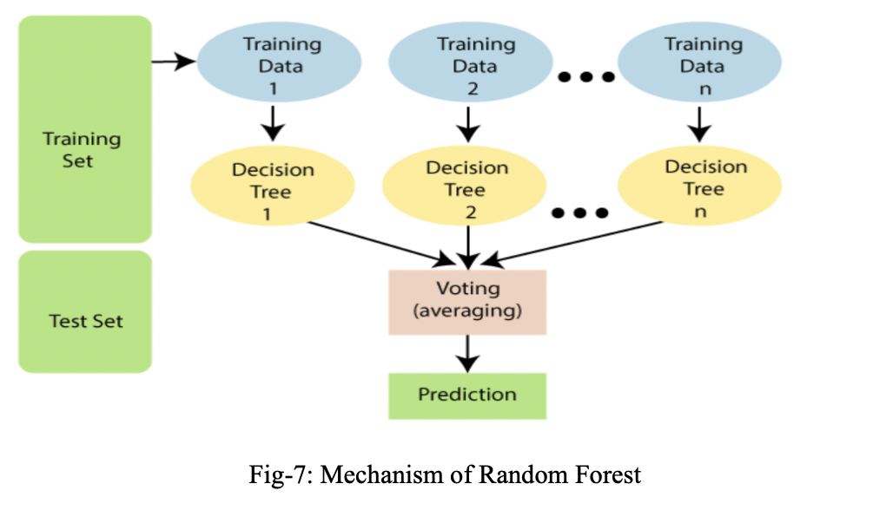
4.RANDOM FOREST-
"Random Forest is a classifier that comprises a number of decision trees on various subsets of the provided dataset and takes the average to increase the prediction accuracy of that dataset." Instead of depending on a single decision tree, the random forest considers the forecast from each tree and guesses the result based on the predictions that have received the most votes.
3. KNN-
The K-NN method places the new case in the category that is most similar to the available categories based on the assumption that the new instance and the data are comparable to the examples that are already accessible.

Slide 19
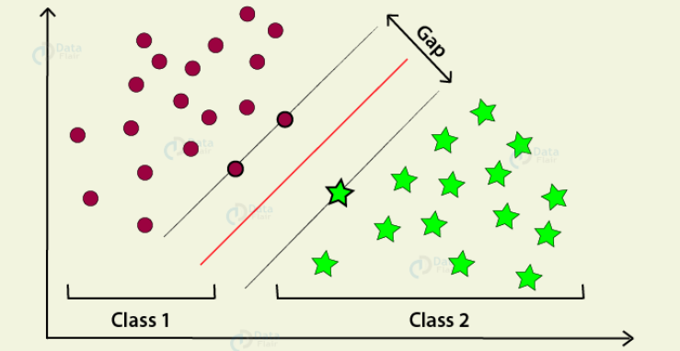
5 SVM ALGORITHM -
For classification, regression, and outliers identification, support vector machines are a collection of supervised learning techniques
Support vector regression (SVR), an extension of support vector classification, is one example of a specific sort of SVM you might employ for particular machine learning challenges (SVC).
The essential thing to bear in mind in this situation is that they are merely mathematical equations that have been optimised to provide you with the most accurate result in the shortest amount of time.

Slide 20





RESULT
ALGORITHM NAME | ACCURACY | SNAPSHOT
DECISION TREE | 0.90704
LOGISTIC REGRESSION | 0.94716
KNN | 0.94250
RANDOM FOREST | 0.94716
SVM | 0.94716

Slide 21
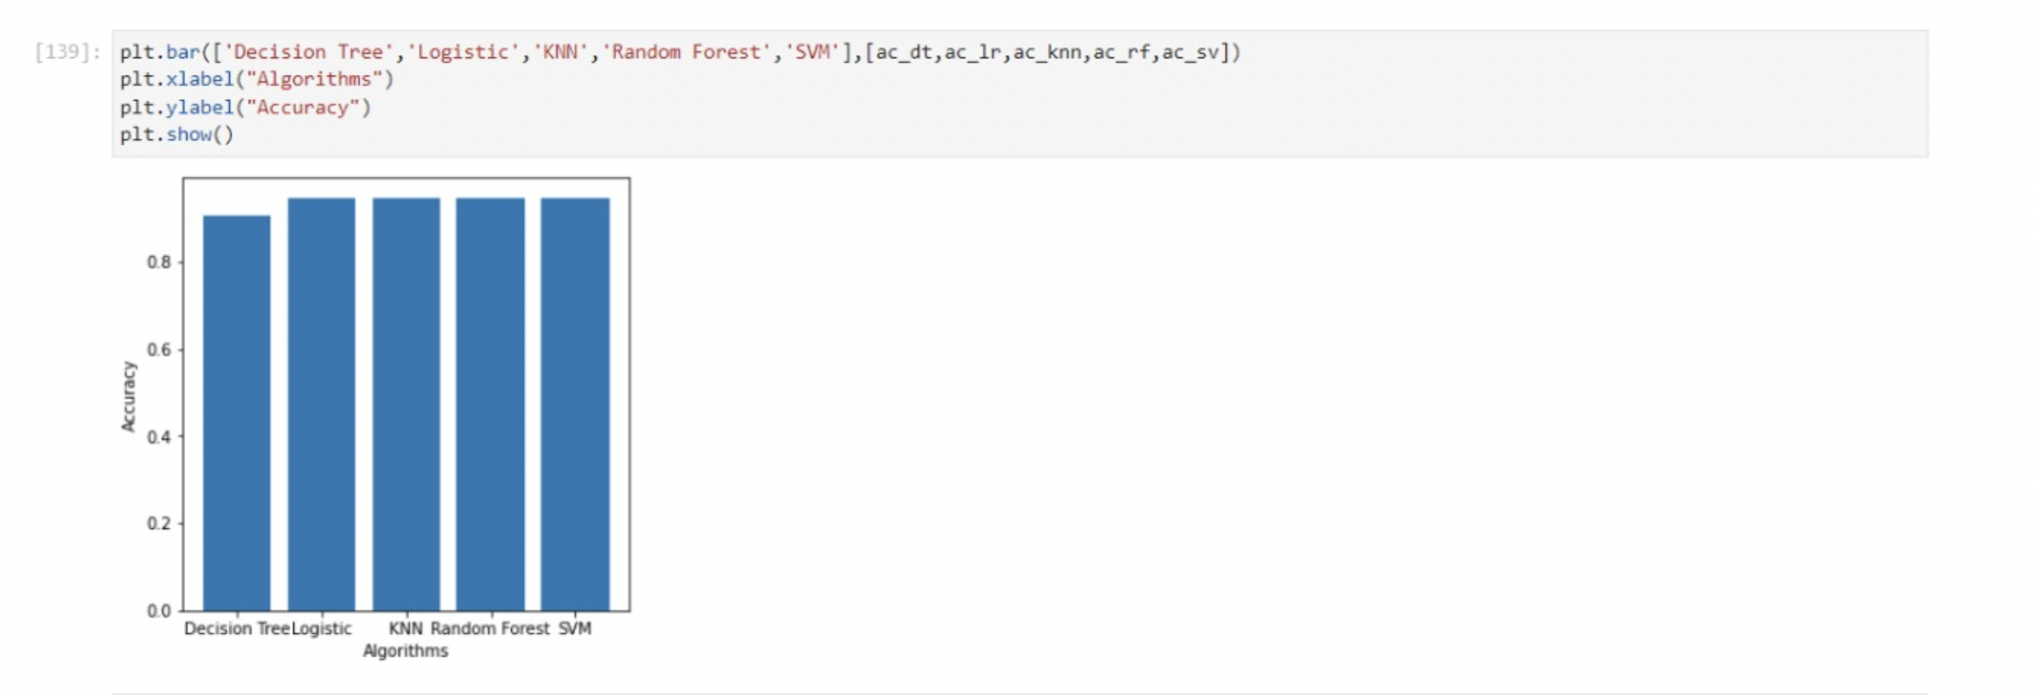
RESULT
COMPARITIVE CHART OF ALL ACCURACIES PLOTTED AS BAR GRAPH

Slide 22
Conclusion:-
By the application of five algorithms that we have included in our paper there are many other algorithms that can also be employed in a similar way which may give similar or better results and hands there is an infinite number of constant combinations that we may employ in order to achieve greater accuracies and remove the false negatives as well as the false positives.
By comparing various accuracies that we have obtained from machine learning algorithms we can easily see which has the best and which might need extra usage of accuracy boosting algorithms or other optimization techniques in order to achieve better results.
We have also successfully showcased the importance of preprocessing outside input data sets by the usage of exploratory data analysis as well as normalization and visualization techniques and how they can increase our accuracy.
FUTURE WORK: Work on the imbalance of the data

Slide 23
References
[1] Li, X., Liu, H., Du, X., Zhang, P., Hu, G., Xie, G., ... & Xie, X. (2016). Integrated machine learning approaches for predicting ischemic stroke and thromboembolism in atrial fibrillation. In AMIA Annual Symposium Proceedings (Vol. 2016, p. 799). American Medical Informatics Association.
[2] Paikaray, D., & Mehta, A. K. (2022). An extensive approach towards heart stroke prediction using machine learning with ensemble classifier. In Proceedings of the International Conference on Paradigms of Communication, Computing and Data Sciences (pp. 767-777). Springer, Singapore.
[3] Cheon, S., Kim, J., & Lim, J. (2019). The use of deep learning to predict stroke patient mortality. International journal of environmental research and public health, 16(11), 1876.
[4] Kim, J. K., Lv, Z., Park, D., & Chang, M. C. (2022). Practical machine learning model to predict the recovery of motor function in patients with stroke. European Neurology, 1-7.
[5] Heo, J., Yoo, J., Lee, H., Lee, I. H., Kim, J. S., Park, E., ... & Nam, H. S. (2022). Prediction of Hidden Coronary Artery Disease Using Machine Learning in Patients With Acute Ischemic Stroke. Neurology.
[6] Heo, J., Yoo, J., Lee, H., Lee, I. H., Kim, J. S., Park, E., ... & Nam, H. S. (2022). Prediction of Hidden Coronary Artery Disease Using Machine Learning in Patients With Acute Ischemic Stroke. Neurology.
[7] Rana, C., Chitre, N., Poyekar, B., & Bide, P. (2021, July). Stroke Prediction Using Smote-Tomek and Neural Network. In 2021 12th International Conference on Computing Communication and Networking Technologies (ICCCNT) (pp. 1-5).
[8] https://www.analyticsvidhya.com/blog/2021/05/how-to-createa-stroke-prediction-model/
[9] https://arxiv.org/abs/2203.00497
[10] https://www.kaggle.com/datasets/fedesoriano/strokeprediction-datase

Slide 24
Thank You

